Slide 1

DATA ANALYST PORTFOLIO
Scale Without Profit: A Retail Sales Case Study
An analytical deep-dive into 1,053 days of daily trading data for a single retail product — uncovering the structural gap between volume and profitability, and the hidden cost of promotional pricing.
Dataset Scope
Core Business Question
30 Dec 2013 – 16 Nov 2016 · 1,053 daily records · One product · Fields: Date, Sales, Cost of Sales, Quantity Sold
The product generates substantial sales volume — but do the economics work? This analysis develops key metrics, identifies promotional behaviour, and surfaces the structural pricing challenge.
Source: Sales Case Study.xlsx · CONFIDENTIAL

Slide 2
EXECUTIVE KPI OVERVIEW
R186.9m in Sales. R7.1m in Losses. Demand Is Not the Problem.
Across the full observation period, customers purchased 5.28 million units and generated R186.9m in revenue. Yet cost of sales exceeded revenue by R7.1m — a structural economics problem, not a demand problem.
R186.9m
R194.0m
Total Sales
Total Cost of Sales
Rand value of all sales across 1,053 trading days
Exceeds revenue — the core structural issue
5.28m
-R7.1m
Units Sold
Total Gross Profit
Total quantity across the full period
Overall gross margin of -3.81%
R35.40
5,014
Avg Unit Price
Avg Daily Units
Weighted average unit sales price
Average daily quantity sold
Source: Sales Case Study.xlsx

Slide 3
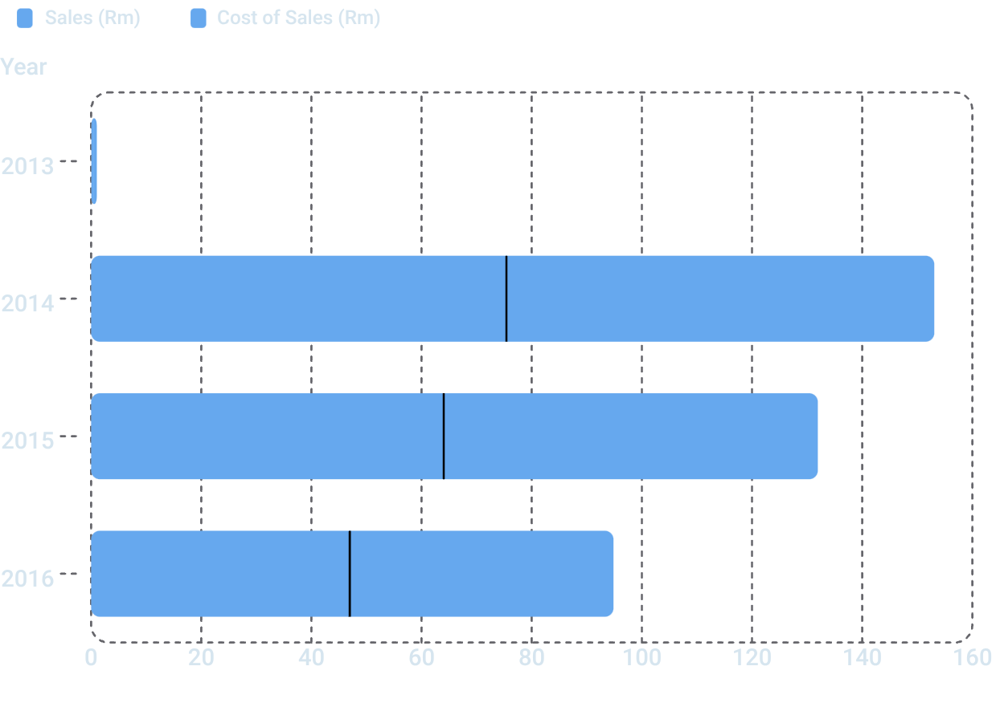
SALES VS COST ANALYSIS
Cost of Sales Consistently Outpaces Revenue — Every Single Year
The Gap That Matters
In every year on record, cost of sales exceeds revenue. The gap is not a rounding error — it is a structural feature of the product's pricing model.
Source: Sales Case Study.xlsx
2014 — Highest Volume Year
2015 — Worst Margin Year
2016 — Improving, Not Fixed
R75.4m sales vs R77.7m cost · Loss: -R2.27m
R64.0m sales vs R67.9m cost · Loss: -R3.90m
R47.0m sales vs R47.9m cost · Loss: -R0.94m

Slide 4
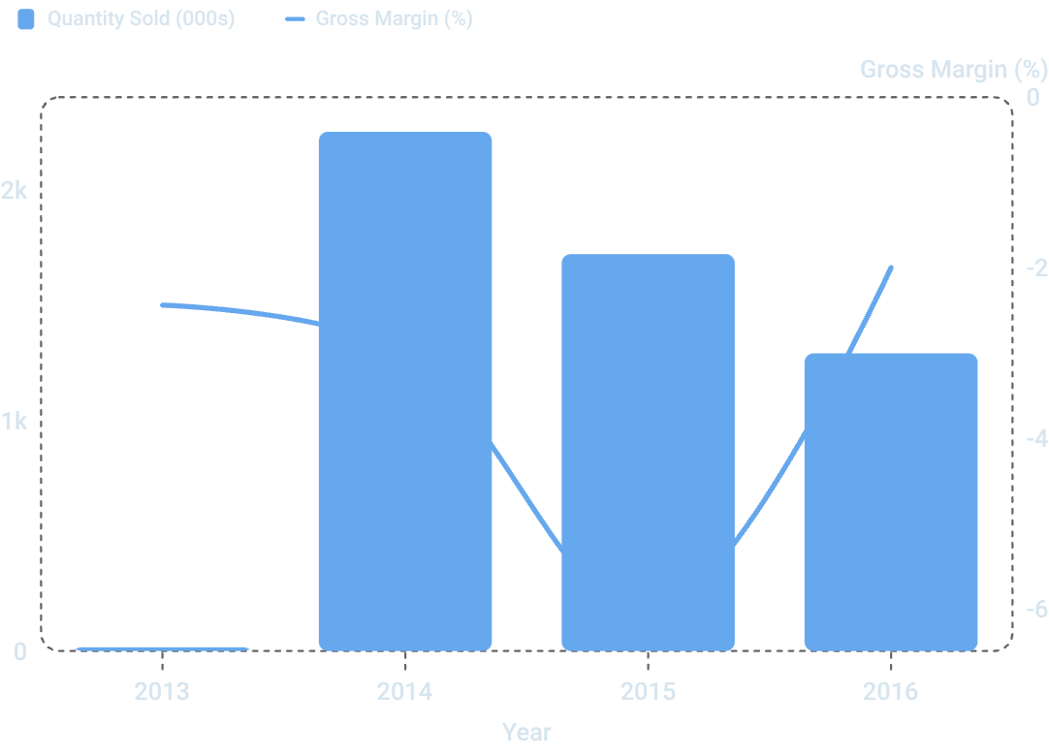
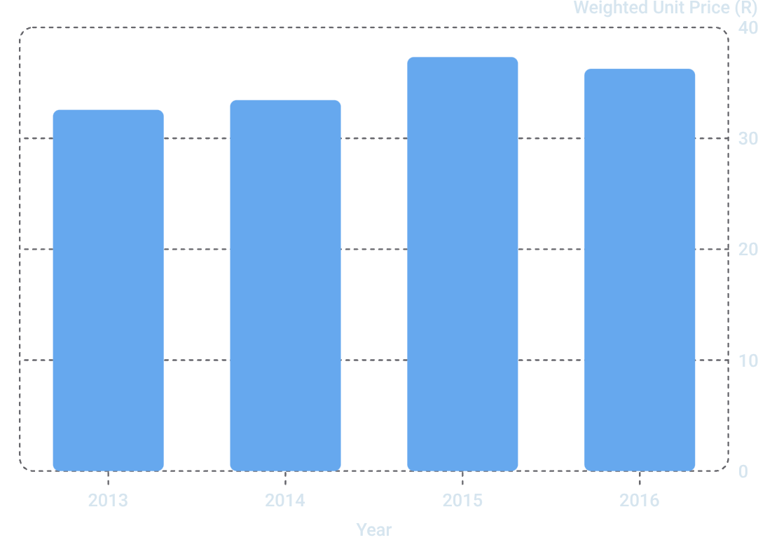
ANNUAL TREND ANALYSIS
Higher Prices in 2015 Produced the Worst Margin — Volume Alone Doesn't Save You Either
Annual Unit Price vs Gross Margin
2015 had the highest unit price (R37.33) yet the worst gross margin (-6.09%) and the largest annual loss (-R3.90m). Higher price alone does not guarantee profitability.
Source: Sales Case Study.xlsx

Slide 5

DAILY EXTREMES
The Best and Worst Days Tell the Full Story of Price-Cost Risk
📈 Highest Sales Day
✅ Best Margin Day
📉 Worst Margin Day
1 March 2014
Sales: R846,678
Units: 26,410
Unit Price: R32.06
Gross Profit: -R25,403
Margin: -3.00%
The biggest revenue day was also a significant loss day — high volume at a low price amplified the cost gap.
11 July 2016
Sales: R45,839
Units: 1,090
Unit Price: R42.05
Gross Profit: +R6,608
Margin: +14.42%
The only clearly profitable day on record — achieved at a higher unit price with lower volume.
29 November 2015
Sales: R238,638
Units: 7,139
Unit Price: R33.43
Gross Profit: -R35,456
Margin: -14.86%
The worst margin day occurred in 2015 — the same year with the highest annual unit price, confirming intra-year pricing volatility.
The contrast between the best margin day (R42.05/unit, +14.42%) and the worst (R33.43/unit, -14.86%) suggests a viable price zone exists — the challenge is sustaining it at scale.
Source: Sales Case Study.xlsx

Slide 6

PROMOTION METHODOLOGY
Promotion Periods Are Analytically Identified — Not Confirmed in the Source Data
Why This Matters
01
The source dataset does not contain an explicit promotion flag. To fulfil the case study objective, three candidate promotional periods were identified analytically — defined as seven-day windows showing some of the largest sustained price reductions versus the immediately preceding seven days.
These are labelled "analytically identified promotion candidates" throughout this analysis. They represent an analytical hypothesis, not causal proof of a promotion event.
Identify Price Drops
Scan daily unit price series for seven-day windows with the largest sustained price reductions vs prior seven days
02
Elasticity Method
Define Baseline
Simple arc-style Price Elasticity of Demand was applied:
Use the immediately preceding seven-day window as the comparison period for price and quantity
03
Calculate PED
Each candidate period is compared against the immediately preceding seven-day baseline window.
Apply arc elasticity: % change in quantity ÷ % change in price across the two windows
04
Assess Economics
Compare gross margin, gross profit/unit, and total gross profit for both windows
Inferred promotions cannot confirm causality. A price drop may reflect other factors. Separate confirmed promotion dates should be added to the source data for rigorous future analysis.

Slide 7
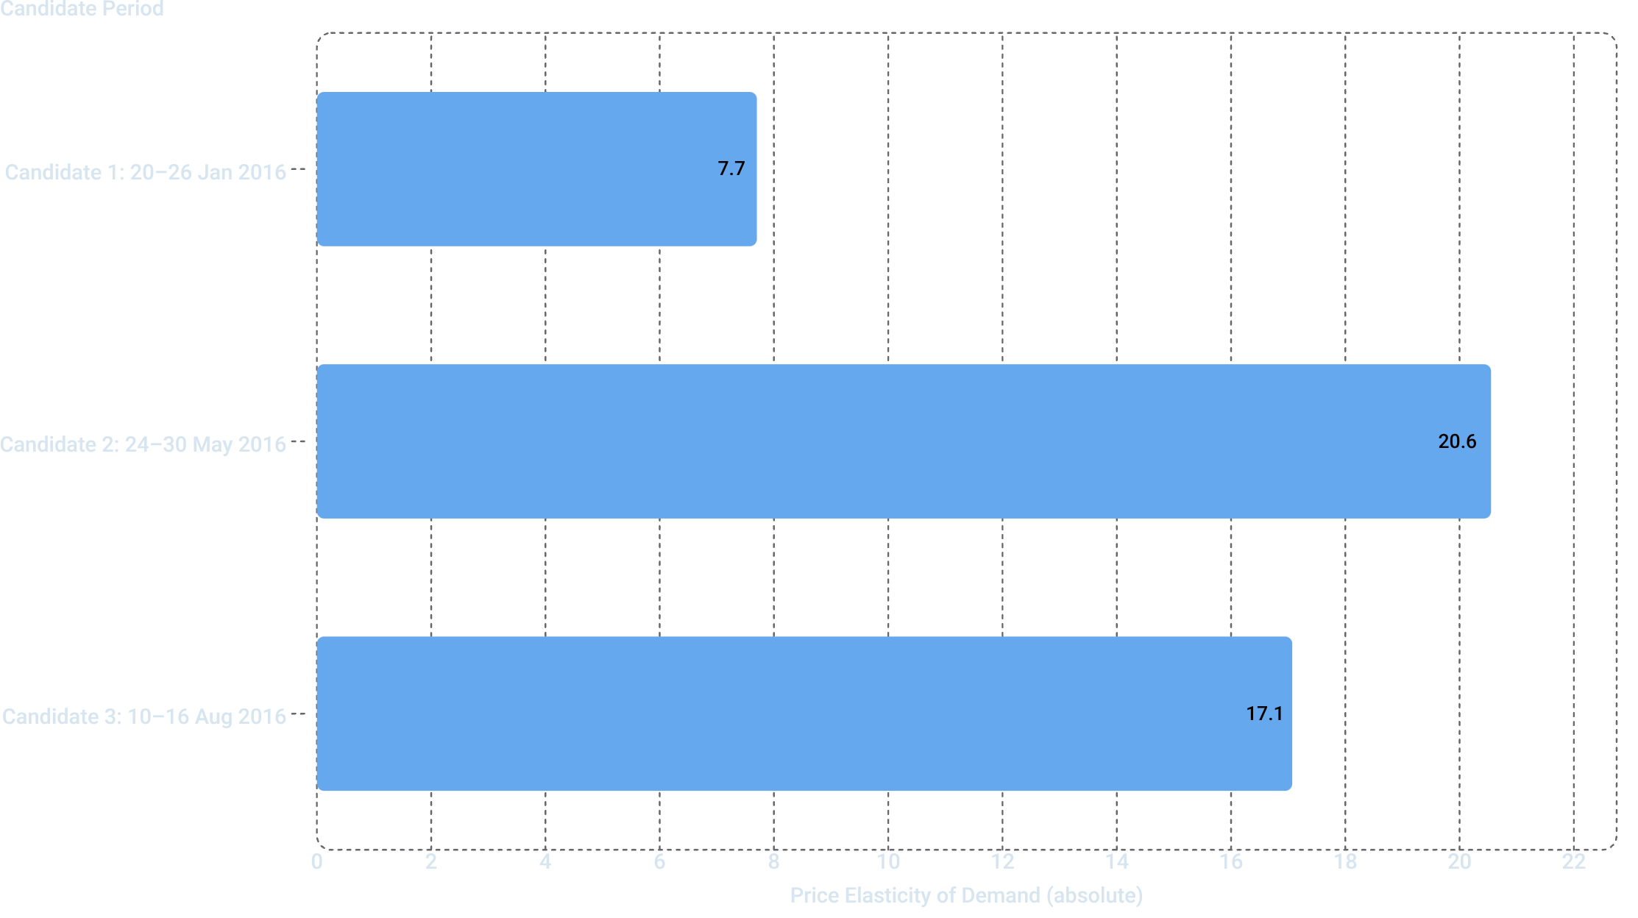
PRICE ELASTICITY OF DEMAND
Price Cuts of ~17% Triggered Volume Surges of 125%–378% — But Every Candidate Period Lost Money
Candidate Period Detail
Prior-Week Comparison
Period | Price Δ | Qty Δ | PED | Promo Margin
20–26 Jan 2016 | -16.29% | +125.37% | -7.70 | -9.17%
24–30 May 2016 | -18.39% | +377.77% | -20.55 | -5.99%
10–16 Aug 2016 | -17.83% | +304.39% | -17.07 | -4.88%
Period | Prior Margin | GP/Unit
Jan 2016 candidate | +7.17% | -R3.16
May 2016 candidate | +13.28% | -R2.06
Aug 2016 candidate | +13.92% | -R1.68
In all three cases, the prior week was profitable. The candidate promotion week was loss-making. The business appears to trade margin for volume.
Source: Sales Case Study.xlsx · Promotion periods are analytically identified candidates, not confirmed promotion events.

Slide 8
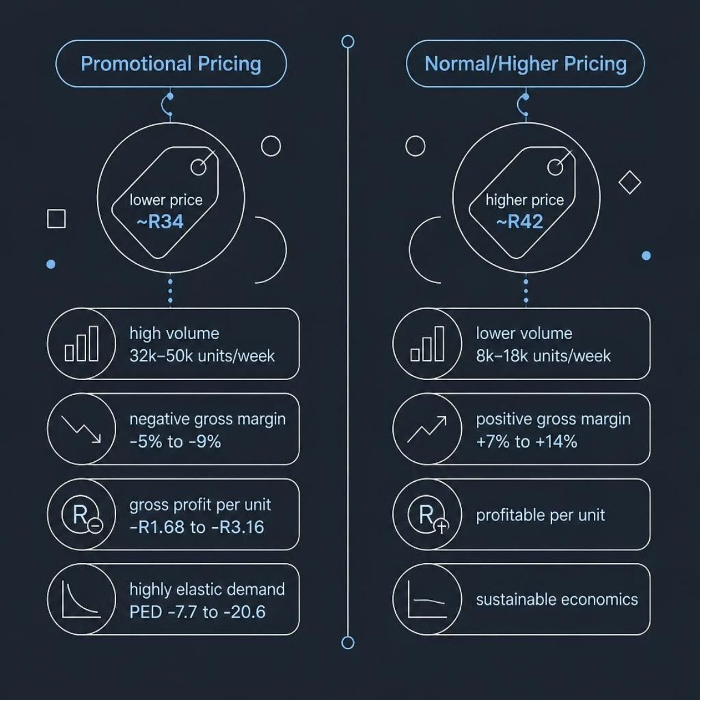
THE PRICE-TO-PROFIT STORY
The Business Trades Margin for Volume — and the Trade Is Currently Losing
The Core Tension
The data reveals a clear and consistent pattern across all three candidate promotion periods: when price falls by approximately 16–18%, quantity sold surges by 125–378%. The product is highly price-elastic.
However, the lower price point sits below the cost-recovery threshold. Every candidate promotion period generates a negative gross margin, while the preceding weeks — at higher prices — were profitable.
The Paradox of 2015
2015 demonstrates that higher prices alone are not sufficient. Despite the highest annual weighted unit price (R37.33), 2015 produced the worst gross margin (-6.09%) and the largest annual loss (-R3.90m). This suggests significant intra-year price volatility — periods of high price mixed with deep discounting — that averaged out to a misleadingly moderate annual figure.
The Opportunity
The best margin day on record (11 Jul 2016, +14.42% at R42.05/unit) proves the product can be profitable. The analytical challenge is identifying the price-volume zone where incremental volume still covers cost — and building a pricing strategy around that zone.
Source: Sales Case Study.xlsx

Slide 9
KEY FINDINGS
Seven Findings That Define the Business Problem
1
Scale without profit
5.28m units sold and R186.9m in revenue across 1,053 days — yet cost of sales exceeded revenue by R7.1m, producing an overall gross margin of -3.81%.
2
The problem is price-cost economics, not demand
Customers respond strongly to this product. The issue is that the price at which volume is generated does not cover the cost of delivering it.
3
Promotional pricing is highly effective for volume — and destructive for margin
Candidate promotion periods produced 125%–378% quantity increases after 16%–18% price reductions (PED: -7.70 to -20.55). All three candidate periods were loss-making; all three prior weeks were profitable.
4
Higher price does not guarantee profitability
2015 had the highest annual unit price (R37.33) but the worst gross margin (-6.09%) and the largest annual loss (-R3.90m), indicating significant intra-year pricing volatility.
5
A profitable price zone exists but is not sustained
The best margin day (11 Jul 2016, +14.42% at R42.05/unit) proves profitability is achievable. The challenge is sustaining it at meaningful volume.
6
2016 shows early signs of improvement
Gross margin improved to -2.00% in 2016 — the best annual margin on record — suggesting the pricing strategy may be moving in the right direction, albeit still loss-making.
7
Promotion identification requires better data
The absence of a promotion flag in the source data limits causal analysis. All promotion findings are analytical hypotheses based on price-drop patterns, not confirmed promotion events.
Source: Sales Case Study.xlsx

Slide 10
RECOMMENDATIONS
Six Actions to Move From Volume-Led Losses to Margin-Aware Growth
1
1
Redefine Promotion Success Metrics
Add a Promotion Flag to Source Data
Stop evaluating promotions on volume or sales alone. Include gross profit and gross profit per unit as mandatory guardrails in every promotion review.
Separate confirmed promotion dates from normal trading dates in the source dataset. This is the single most important data quality improvement to enable rigorous future analysis.
2
2
Establish a Minimum Viable Unit Price
Build a Promotion Test Framework
Calculate the minimum unit price required to cover cost of sales plus a target gross margin. Use this as a hard floor for any promotional or discounting decision.
Implement structured pre-period, promo-period, and post-period comparisons for every future promotion. This enables causal inference rather than analytical hypothesis.
3
3
Test Smaller Discounts
Monitor a Unified KPI Dashboard
The current data shows 16–18% price reductions. Test smaller discounts (e.g. 5–10%) and measure incremental units versus incremental gross profit to find the optimal price-volume trade-off.
Track price, quantity, revenue, gross profit, gross margin %, and gross profit per unit together — not in isolation. No single metric tells the full story.
Calculation Definitions
Daily Sales Price per Unit = Sales ÷ Quantity Sold · Average Unit Sales Price = Total Sales ÷ Total Quantity Sold (weighted average) · Gross Profit = Sales − Cost of Sales · Daily % Gross Profit = Gross Profit ÷ Sales · Gross Profit per Unit = Gross Profit ÷ Quantity Sold · Price Elasticity of Demand = % Δ Quantity Sold ÷ % Δ Price
Source: Sales Case Study.xlsx · Dataset: 1,053 daily records, 30 Dec 2013 – 16 Nov 2016 · Promotion periods are analytically identified candidates, not confirmed promotion events · Analysis prepared for Data Analyst portfolio.

